Slide 1
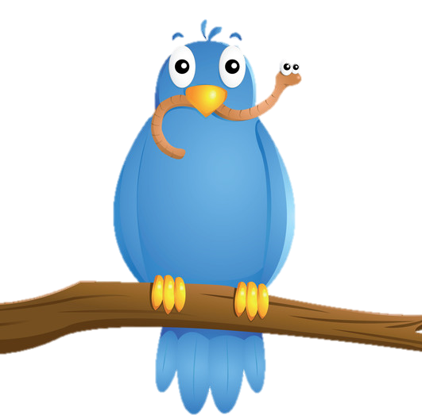
Early Birds
Night Owls

